Slide 1
Drupal 8
Theming

Slide 2
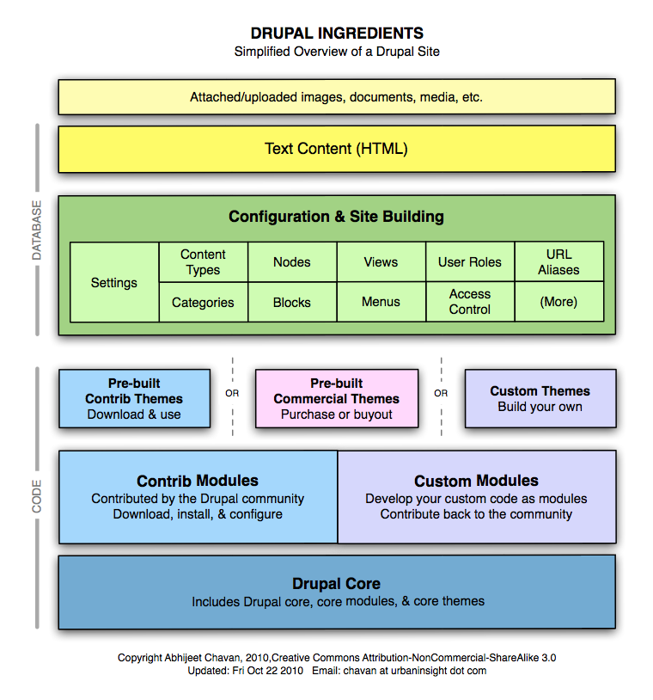

Slide 3
Theming in Drupal 8
The theming has undergone many changes since Drupal 7, especially the deep integration with Twig – a popular templating engine for PHP, which opens the door to more robust, scalable and secure themes.

Slide 4
New Way Theming in Drupal 8
yourtheme.info.yml The use of *.info.yml file as a replacement for *.info file is definitely giving more options and flexibility on the theme configuration.
yourtheme.libraries.yml This a configuration file to define assets for your theme – notably for css and javascript files.

Slide 5
New Way Theming in Drupal 8
yourtheme.breakpoints.yml This a configuration file to setup breakpoints for your responsive custom theme.
yourtheme.theme This file contains all of the preprocess functions, similar to the template.php file in Drupal 7.

Slide 6
New Way Theming in Drupal 8
Twig template file (*.html.twig) The usage of Twig gives more robustness on the front-end. The new syntax is cleaner and addresses a lot of common security pitfalls. Usually all the*.html.twig files are put under the templates sub-folder.

Slide 7
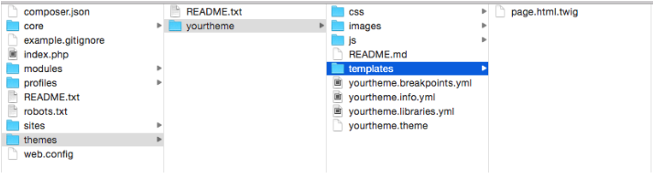
Drupal 8 Basic Folder Structure

Slide 8
yourtheme.info.yml
name: YourTheme
description: 'A Cool theme by you.'
type: theme
package: Custom
base theme: classy
core: 8.x
screenshot: yourtheme.png

Slide 9
yourtheme.info.yml
libraries:
- yourtheme/global-styling
regions:
header: ‘Header’
primary_menu: 'Primary menu'
secondary_menu: 'Secondary menu'
help: Help

Slide 10
yourtheme.info.yml
page_top: 'Page top'
page_bottom: 'Page bottom'
featured_top: 'Featured top'
breadcrumb: Breadcrumb
content: Content
sidebar_first: 'Sidebar first'
sidebar_second: 'Sidebar second'

Slide 11
yourtheme.info.yml
featured_bottom_first: 'Featured bottom first'
featured_bottom_second: 'Featured bottom second'
featured_bottom_third: 'Featured bottom third'
footer_first: 'Footer first'
footer_second: 'Footer second'
footer_third: 'Footer third'
footer_fourth: 'Footer fourth'
footer_fifth: 'Footer fifth’

Slide 12
yourtheme.libraries.yml
This file contain references to the assets – notably is the CSS and JavaScript files that needs to be loaded from your theme.
This is the basic setup of what could be contained in the *.libraries.yml file.

Slide 13
yourtheme.libraries.yml
global-styling:
css:
theme:
css/styles.css: {}
css/layout.css: {}
css/print.css: { media: print }
js:
js/yourtheme.js: {}
js/custom-library.js: {}

Slide 14
yourtheme.libraries.yml
dependencies:
- core/jquery
- core/drupal
custom-stuff:
css:
theme:
css/print.css: {}
css/another-style.css: {}
js:
js/yourtheme.js: {}
js/haha.js: {}

Slide 15
Making Theme Responsive
In order to setup the breakpoints configuration, you need to create a file called yourtheme.breakpoints.yml, with basic code as shown below:
yourtheme.mobile:
label: mobile
mediaQuery: '(min-width: 0px)'
weight: 2
multipliers:
- 1x

Slide 16
Making Theme Responsive
yourtheme.narrow:
label: narrow
mediaQuery: 'all and (min-width: 560px) and (max-width: 860px)'
weight: 1
multipliers:
- 1x
yourtheme.wide:
label: wide
mediaQuery: 'all and (min-width: 851px)'
weight: 0
multipliers:
- 1x

Slide 17
Making Theme Responsive
Each section represents one breakpoint, which consists of a unique machine name (ie:yourtheme.mobile, yourtheme.narrow, yourtheme.wide), with properties explained below:
label A human readable label for the breakpoint.
mediaQuery Media query
weight Order for the breakpoints to take place.
multipliers Supported pixel resolution multipliers.

Slide 18
yourtheme.theme
This file contains the hookpreprocess to alter or make modification to the theme. This file serves the same purpose as template.php in Drupal 7.
Below is a simple example of code on how to add custom assets library to our custom theme.
function yourtheme_preprocess_page(&$variables) {
$variables['#attached']['library'] = array('yourtheme/global-styling', 'yourtheme/custom-stuff');
}
As you can see we use hook_preprocess_page(), and we add global-styling and custom-stuff via the #attached library array that comes from $variables.

Slide 19
Twig template file (*.html.twig)
Another significant change introduced in Drupal 8 is the use of the popular PHP templating engine Twig, to replace the PHPTemplate-based theme system in Drupal 7.
For example, if you used to have page.tpl.php in Drupal 7, it has now been replaced by page.html.twig in Drupal 8.
For the sake of easy management, Twig template files are put under the templates sub-directory from your custom theme.
Here is a list of possible Twig template files that are available in Drupal 8 by default.

Slide 20
Twig template file (*.html.twig)
HTML (template)
html.html.twig
Page template
page.html.twig
page–node.html.twig
page–node–<nid>.html.twig, ie: page–node–1.html.twig
page–node–edit.html.twig

Slide 21
Regions
region.html.twig
region–<region-name>.html.twig, ie: region–right-sidebar.html.twig
Blocks
block–<module-name>.html.twig, ie: block–cust-mod.html.twig
block–<module-name>–<delta>.html.twig, ie: block–cust-mod–1.html.twig
Nodes
node.html.twig
node–<content-type>.html.twig, ie: node–article.html.twig
node–<nid>.html.twig, ie: node–<nid>.html.twig

Slide 22
Taxonomy terms
taxonomy-term.html.twig
taxonomy-term–<vocab-machine-name>.html.twig
node–<nid>.html.twig, ie: node–<nid>.html.twig, ie: taxonomy-term–ingredients.html.twig
taxonomy-term–<tid>.html.twig, ie: taxonomy-term–1.html.twig
Fields
field–<field-type>.html.twig, ie: field–long-text.html.twig
field–<field-name>.html.twig, ie: field–phone-number.html.twig
Comments
comment.html.twig
comment-wrapper.html.twig

Slide 23
Forums
For forum containers:
forums–containers.html.twig
forums–<forum-id>.html.twig
forums–containers–<forum-id>.html.twig
For forum topics:
forums–topics.html.twig
forums–<forum-id>.html.twig
forums–containers–<forum-id>.html.twig
Maintenance page
maintenance-page.html.twig
Search result
search-result.html.twig

Slide 24
In terms of coding, Twig template files in Drupal 8 are not much different to PHPTemplate files in Drupal 7. In both cases you’re essentially writing HTML. The difference is how you define variables and define conditional logic within it.
Here are some examples:
Docblock PHPTemplate
<?php
/**
* @file
* File description
*/
?>

Slide 25
Twig
{#
/**
* @file
* File description
*/
#}
Variables Printing a variable: PHPTemplate: <div class="content"><?php print $content; ?></div> Twig: <div class="content">{{ content }}</div>
Printing a hash key item: PHPTemplate: <?php print $item['#item']['alt']; ?> Twig: {{ item['#item'].alt }}
Assigning a variable: PHPTemplate: <?php $custom_var = $content->comments; ?> Twig: {% set custom_var = content.comments %}

Slide 26
Assigning an array: PHPTemplate: <?php $args = array('!author' => $author, '!date' => $created); ?> Twig: {% set args = {'!author': author, '!date': created} %}
Conditionals: PHPTemplate: <?php if ($content->comments): endif; ?> Twig: {% if content.comments %} {% endif %}
PHPTemplate: <?php if (!empty($content->comments)): endif; ?> Twig: {% if content.comments is not empty %} {% endif %}
PHPTemplate: <?php if (isset($content->comments)): endif; ?> Twig: {% if content.comments is defined %} {% endif %}
PHPTemplate: <?php if ($count > 0): endif; ?> Twig: {% if count > 0 %} {% endif %}

Slide 27
Control structures: PHPTemplate: <?php foreach ($users as $user) {} ?> Twig: {% for user in users %} {% endfor %}
Filters: Check_plain: PHPTemplate: <?php print check_plain($title); ?> Twig: {{ title|striptags }}
Translate: PHPTemplate: <?php print t('Home'); ?> Twig: {{ 'Home'|t }}
Translate with substitutions: PHPTemplate: <?php print t('Welcome, @username', array('@username' => $user->name)); ?> Twig: {{ 'Welcome, @username'|t({ '@username': user.name }) }}

Slide 28
Designing & Developing Custom Theme

Slide 29
Before You Begin
You should understand the basics of:
HTML and CSS: how they are used to make websites
PHP: what it is, and how it is used to enhance
CMS's: what they are, and how they are used to power websites
Drupal: How to set up a simple website using it

Slide 30
Design the website.
Draw all the parts of a basic web-page, including the header, navigation menu (which may be just below the header or in a sidebar), the page body (for the content), and the footer. You may have other areas in your design.

Slide 31
Develop the website using HTML and CSS
Just like in the website design step, it is probably most efficient to only create the web pages of the site that have their own unique layouts, such as the Home page and Contact Us page. Keep the layout as simple as possible, and use modern practices and conventions where possible (such as HTML5 and CSS3). At this point, don't add any server-side scripting (such as PHP), and keep client-side scripting (such as Javascript) to a minimum, in order to not interfere with Drupal's code; this can be added later.

Slide 32
Set up Drupal to begin theming
Understand Drupal’s web page structure and convert your static pages to it.
HTML web pages are known as ‘static’ – which means they aren’t designed to have content that regularly changes – and are built using block-type tags such as ‘divs’ (and ‘header’, ‘footer’, etc. in HTML5).
Drupal web pages are a combination of static parts (HTML) and dynamic parts – parts that contain content that is expected to be changed regularly. These dynamic parts are called ‘regions’ in Drupal. An example of a region is a sidebar, where you might want to insert navigational links, a search box, social media buttons, and so on.

Slide 33
Set up Drupal to begin theming
The things that you can put into regions are called ‘blocks’ in Drupal. For example, a search box or a menu are commonly-used blocks. You can insert blocks into regions, re-arrange the blocks, and remove blocks from regions when you log into Drupal on the Structure > Blocks page. Many of the available blocks in a typical Drupal website are provided by the installed modules, but you can create your own blocks on the Blocks page.

Slide 34
Set up Drupal to begin theming
The content of each web page (the body text, headings, images, and so on) are also placed into a region: the ‘Content’ region, which is required for all Drupal themes. The content of each web page (or blog post or custom content type) is called a ‘node’, and is packaged into the Main page content block. In other words, the content of the About Us page is saved into node (with a node type of ‘page’, of course), and is output to the Main page content block, which is placed in the Content region.

Slide 35
Creating the Theme Files
Set up the theme folder. In this folder create a .info file which contains the theme's purpose and gives information about how it is used. List what goes into it. In the folder add screenshots. and a CSS folder.

Slide 36
Create the template files
Drupal ‘template’ files (that have a file name ending in ‘.html.twig’) are used by Drupal to structure the output of each web page. Standard templates include:
html.html.twig
page.html.twig
block.html.twig
node.html.twig

Slide 37
Create the template files
Each web page that Drupal outputs (the ‘Home page’ for example) will use the htmltemplate once, the page template once, and the region, block and node templates at least once each. If you'd like to see the typical PHP code and HTML markup that goes into each of these templates, you can look at the template files in the directory of the core Drupal themes in the drupal > themes folder (not the drupal > sites > all > themesfolder).

Slide 38
Insert the Process and Pre-process functions
To understand these functions, you first need to understand how drupal saves and outputs content and HTML markup. As you should have seen in the templates in the previous step, all Drupal templates have several variables available to them that they can output using functions like {{ page['content'] }}. In that example, the variable content (which is stored in the page array rather than as a variable by itself; its just how Drupal does it) stores all the text that the user typed into the web page's 'body' when the user was logged into Drupal.

Slide 39
Install the Theme and Finishing Touches
Install the theme in Drupal, set up the required views and add the required nodes and regions.
Install additional useful modules which enhance appearance, security and the functionality.

Slide 40
Add website content to complete the site.

Slide 41
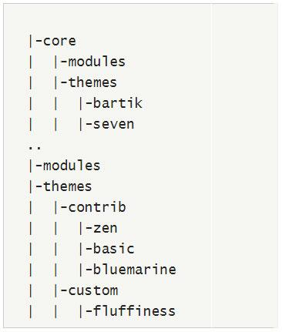
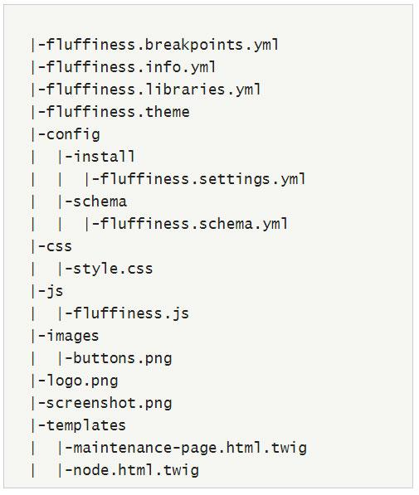
File structures have changed
D8 Base Path
D8 Theme

Slide 42
File types have changed
THEME_NAME.info -> THEME_NAME.info.yml template.php -> THEME_NAME.theme hook_template.tpl.php -> hook_template.html.twig

Slide 43
dcu.info
name = DCU
description = An example theme for Drupal Camp Utah
base theme = Omega
screenshot = screenshot.png
engine = phptemplate
core = 7.x
stylesheets[all][] = css/dcu.styles.css
scripts[] = js/dcu.behaviors.js
regions[content] = Content
...

Slide 44
dcu.info.yml
name: DCU
type: theme
description: An example theme for Drupal Camp Utah
base theme: Omega
engine = phptemplate
screenshot: screenshot.png
core: 8.x
libraries:
- dcu/global-styling
#Regions
regions:
navigation: Navigation
header: Header
content: Content
machine_readable: Human Readable
stylesheets-remove:
- core/assets/vendor/normalize-css/normalize.css

Slide 45
Libraries
Probably the most notable change in Drupal 8.
Define library: A collection of CSS stylesheets and JS scripts
Can be used globally, or just as needed.
Library Naming (NOT file naming): THEME_NAME/LIB_NAME dcu/global-styling

Slide 46
dcu.libraries.yml
global-styling: #LIBRARY_NAME
version: 1.x
css:
theme:
styles/css/style.css {}
styles/css/print.css { media: print }
js:
js/script.js {}
header:
js/header.js {}
dependencies:
core/jquery
sessions: #LIBRARY_NAME
...
(Yes, jQuery is now included in Core!)

Slide 47
dcu.libraries.yml - CSS
D8 dcu.info.yml:
global-styling:
version: 1.x
css:
theme:
styles/css/style.css {}
styles/css/print.css { media: print }
D7 dcu.info:
stylesheets[all][] = css/global.styles.css
stylesheets[all][] = css/responsive.styles.css
stylesheets[all][] = css/print.css

Slide 48
dcu.libraries.yml - JS
D8 dcu.info.yml:
global-styling:
...
# By default, all JS is loaded in the footer
js:
js/script.js: {}
# But it can be overridden!
js-header:
header: true
js:
js/header.js: {}
js-footer:
js:
js/footer.js: {}
D7 dcu.info:
scripts[] = js/script.js

Slide 49
Attaching a Library to a Page
Options for loading a library:
Every page
A subset of pages
Individual templates
(Remember, THEME_NAME/LIBRARY_NAME is how you reference a library)
To load a library on every page, place in your THEME_NAME.info.yml file.
To load a library on a subset of pages:
<?php
function dcu_preprocess_maintenance_page(&$variables) {
$variables['#attached']['library'][] = dcu/sessions';
}
?>
To load on a Twig template:
{{ attach_library('dcu/sessions') }}

Slide 50
The Themer’s Best Friend
Twig debugging!
To turn on, edit settings.php and services.yml
sites/default/settings.php $settings['twig_debug'] = TRUE; $settings['container_yamls'][] = __DIR__ . '/services.yml';
sites/default/services.yml parameters: twig.config: debug: true
Also Devel -Module
Thanks to Derek Walker (@derekawalker) for helping me out with this.

Slide 51
Templates are now done in Twig (not PHP)
<section id="content-outer-wrapper" class="outer-wrapper clearfix">
<div id="main-layout" class="{{ region_classes.main }}
inner-wrapper clearfix">
{% if page.content %}
{{ page.content }}
{% endif %}
{% if page.sidebar_first %}
{{ page.sidebar_first }}
{% endif %}
{% if page.sidebar_second %}
{{ page.sidebar_second }}
{% endif %}
</div><!-- /#main -->
</section><!-- /#main-outer-wrapper -->
<div class="l-main-wrapper">
<div class="l-main">
<div class="l-content" role="main">
<a id="main-content"></a>
<?php print render($tabs); ?>
<?php print render($page['help']); ?>
<?php if ($action_links): ?>
<ul class="action-links">
<?php print render($action_links); ?>
</ul>
<?php endif; ?>
<?php print render($page['content']); ?>
</div>
<?php print render($page['sidebar_first']); ?>
<?php print render($page['sidebar_second']); ?>
</div>
</div>

Slide 52
Twig Reference & PHP Equivalent
{{ twig_variable }}
{% if twig_variable %} {% elseif twig_variable %} {% else %} {% endif %}
{% for i in 0..10 %} {{ i }} {% endfor %}
echo $php_variable;
if($boolean) else if($boolean) else
for($i = 0; $i < 10; $i++) { echo $i; }

Slide 53
Twig Variables & Preprocess Functions
<body class=”{{ page_class }} main”> <h1>{{ title }} It’s awesome.</h1> ... </body>
<body class=”page_dark_side main”> <h1>Come to the dark side. It’s awesome.</h1> ... </body>

Slide 54
Twig Loops and PHP Arrays
<?php function dcu_preprocess_page(&$variables) { $variables[‘sessions’] = array( ‘auditorium’ => array( ‘title’ => ‘Drupal 8 Theming’, ‘time => ‘11:15 AM’, ), ‘room_b’ => array( ‘title’ => ‘Drulenium’, ‘time’ => ‘11:15 AM’, ), ); } ?>
{% for session in sessions %} {{ session.title }} at {{ session.time }} {% endfor %}
Helpful note: {{ variable_name.key }} for array elements

Slide 55
Now Implement Drupal 8 theme.

